Slide 1

HOSPITAL MANAGEMENT SYSTEM
SUPERVISOR & COORDINATOR BATCH MEMBERS
Mr.N.V.RAVINDHAR, M.E., Ph.D
Professor PRITHIKA A P(212219040026)
Computer Science and Engineering MOUNIKA S C(212219040028)
MEKALA PRANEETH KUMAR (212219040024)

Slide 2
Abstract
The main intention of introducing this system is to reduce the manual work at Health Center Counters.
Every sort of task is performed by the system, such as registering different types of persons, medicine stock, dealers for medicine etc., reducing much paper work and burden of file storage
There are a lot of benefits to the Health center by placing the system at their registration and at drug store office . At the same time the patients are also benefited using this system.
Every step is clearly defined and help is provided through out the application to the user. Even the exceptions are handled well to avoid confusion.
The drug information and the stock of drugs is also provided in this Health Center Management System.The main intention of introducing this system is to reduce the manual work at Health center counters

Slide 3
CONTENTS OF THE PROJECT
Abstract
Introduction
Proposed Methodology
Architecture Diagram
List of Modules
Module Explanation
Module Implementation
References

Slide 4
LITERATURE SURVEY
S.NO | TITLE OF THE PROJECT | AUTHOR NAME | JOURNAL | METHOD AND DESCRIPTION | DRAWBACKS | YEAR
1. | Functional description of online medical management system using modern technology. | Priyanka Patil, Rohini Temkar | International journal on engineering sciences and innovative technology. | Manages the schedule of doctors maintaining the records of patient. | Only admin can access to update the details | 2013
2. | Literature Review on patient scheduling techniques | G.Mageshwari | International journal on Computer Science Engineering | The challenges of patient scheduling and patient scheduling techniques. | Project main aim is to get the patient details | 2012

Slide 5

Introduction
The project Hospital Management system includes storing their details into the system, and also computerized billing in the pharmacy, and labs.
There are a lot of benefits to the Health center by placing the system at their registration and at drug store office . At the same time the patients are also benefited using this system.
Every step is clearly defined and help is provided through out the application to the user. Even the exceptions are handled well to avoid confusion
These project is mainly used for storing the data like pharmacies medicine details,employee details,dealer details etc.

Slide 6
PROBLEM DEFINITION
To gather the information like dealership,customer details, medicine details,employee details etc.
Can update or delete the details
Easy to implement it.

Slide 7

PROPOSED SYSTEM
Deals with classification of brain tumour accurately from the source, big data based on Hadoop framework with SVM classifier.
The proposed methodology consists of the following modules:
Elimination of Secondary attributes
Clustering and Classification

Slide 8
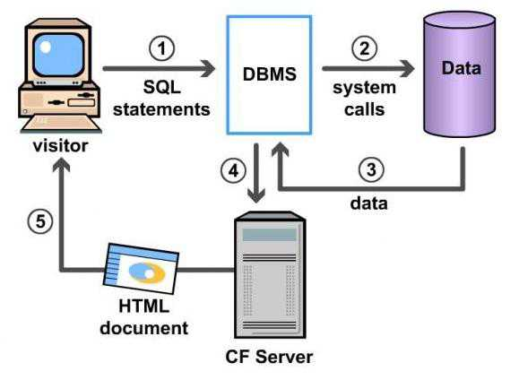
ARCHITECTURE DIAGRAM

Slide 9

LIST OF MODULES
Django
Web Interface Design

Slide 10
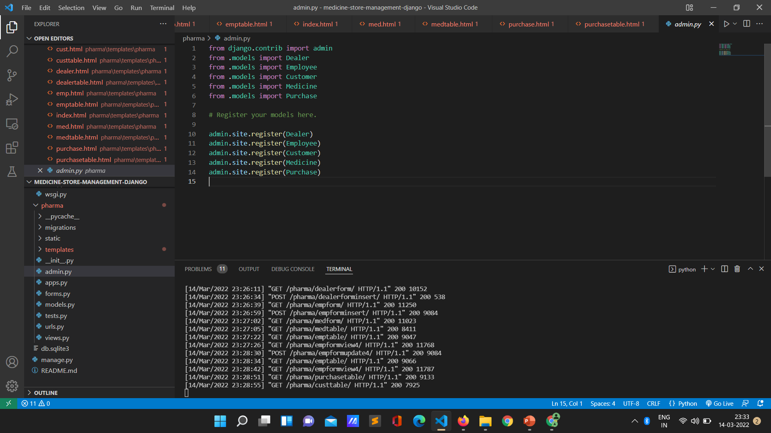

Slide 11
Django
Django is a widely used free, open-source, and high-level web development framework. It provides a lot of features to the developers "out of the box," .
So development can be rapid. However, websites built from it are secured, scalable, and maintainable at the same time.

Slide 12
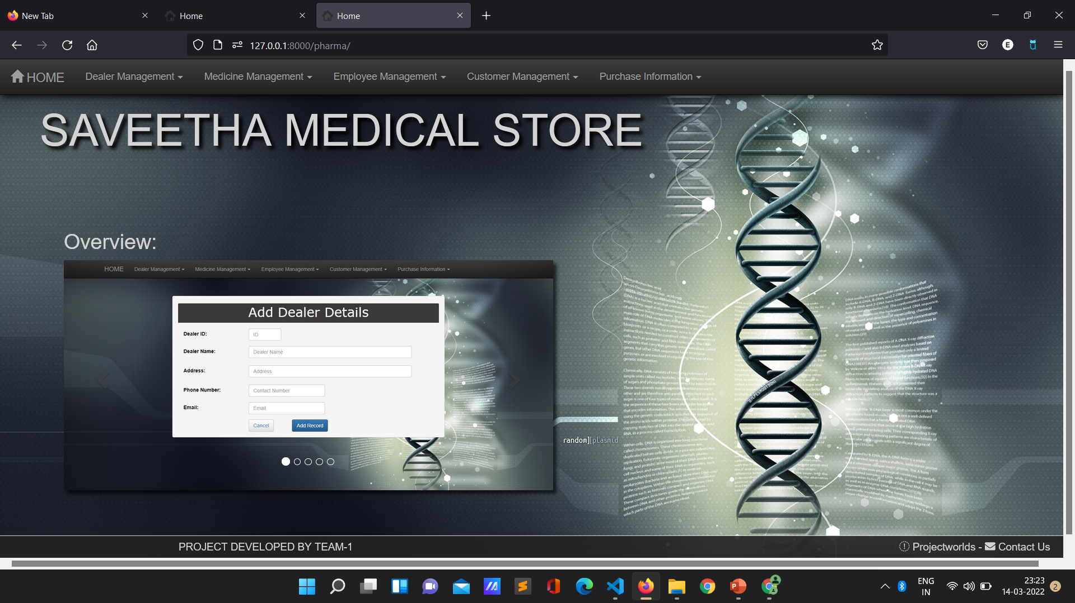
Module Implementation

Slide 13
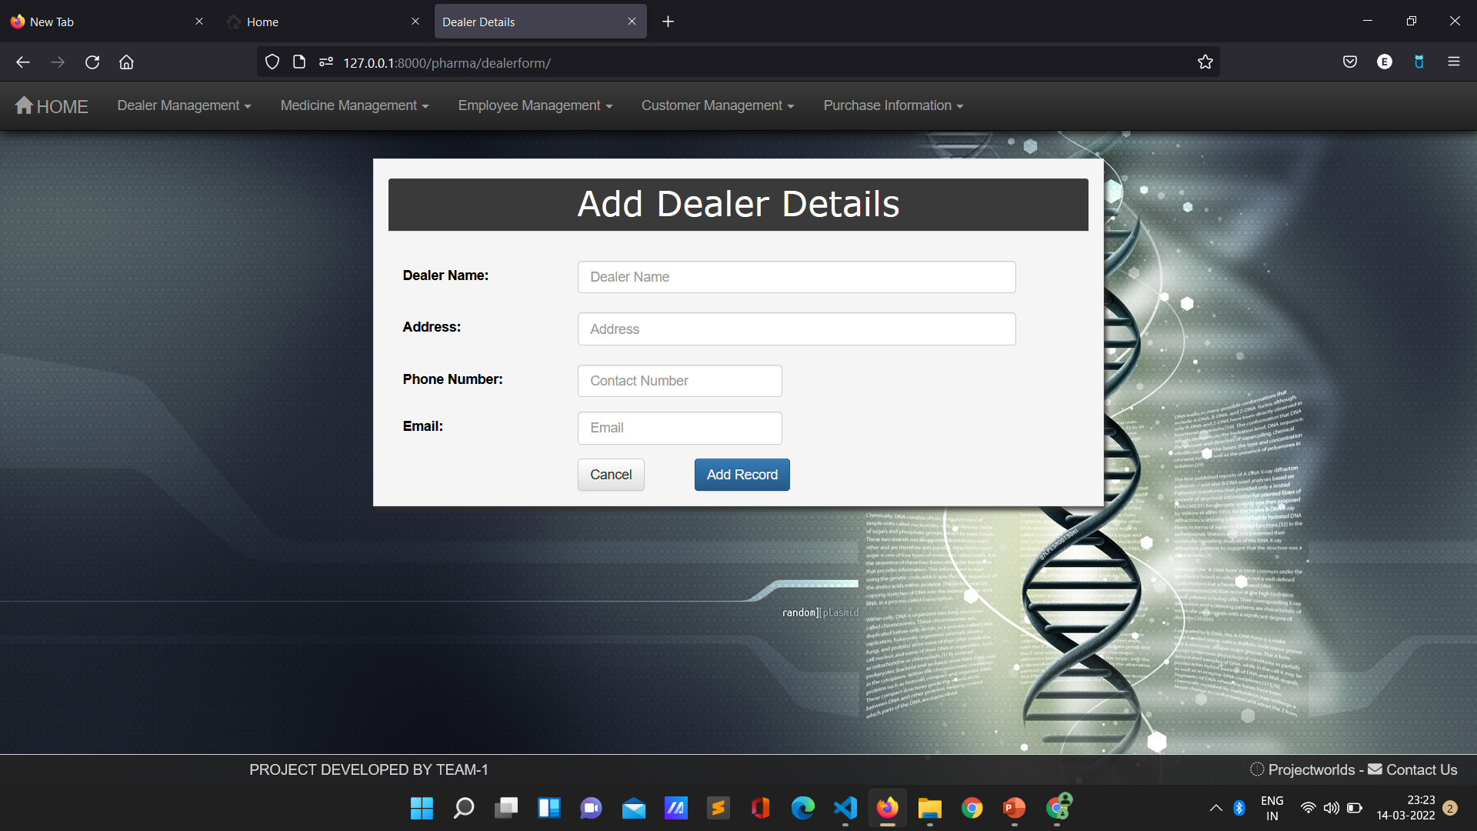
Module Implementation
Screen shot and output of module

Slide 14
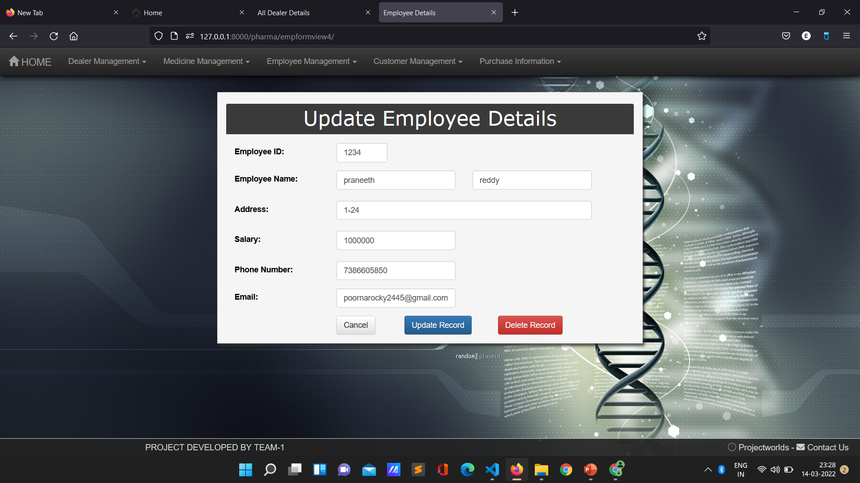
Module Implementation
Screen shot and output of module

Slide 15
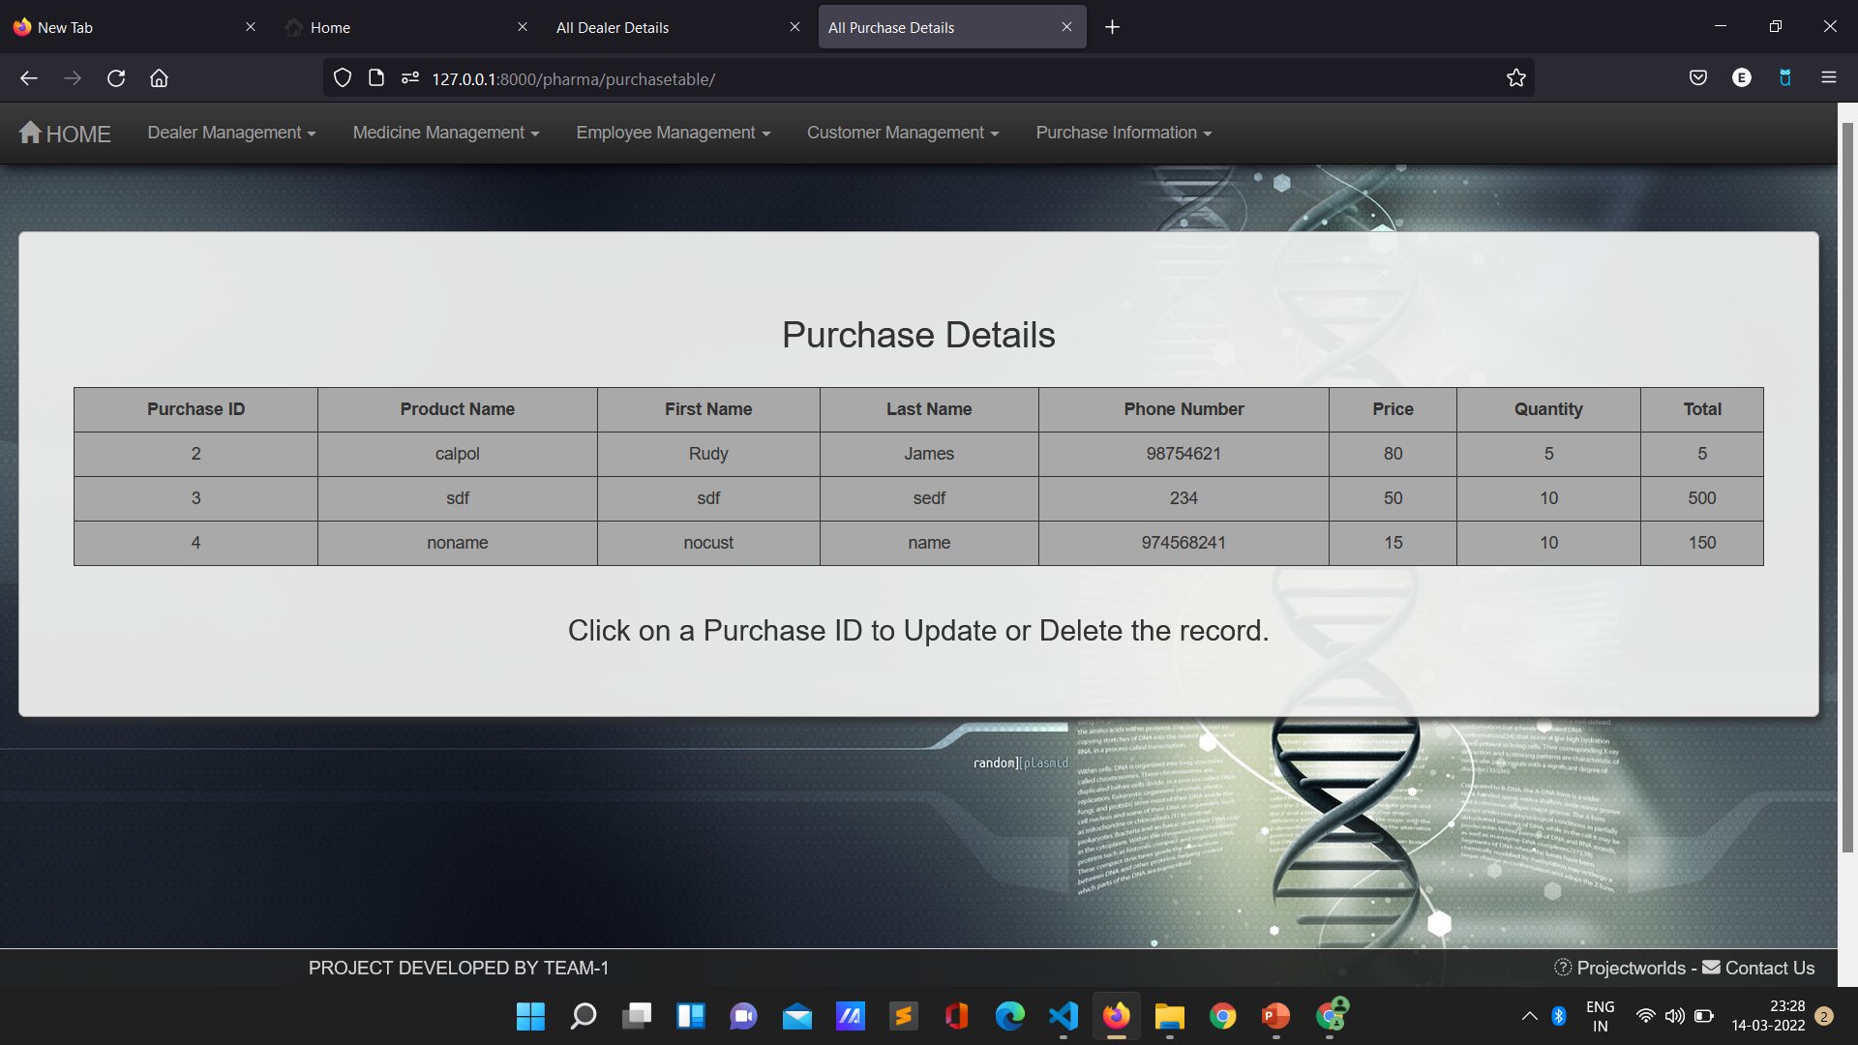
Module Implementation
Screen shot and output of module

Slide 16
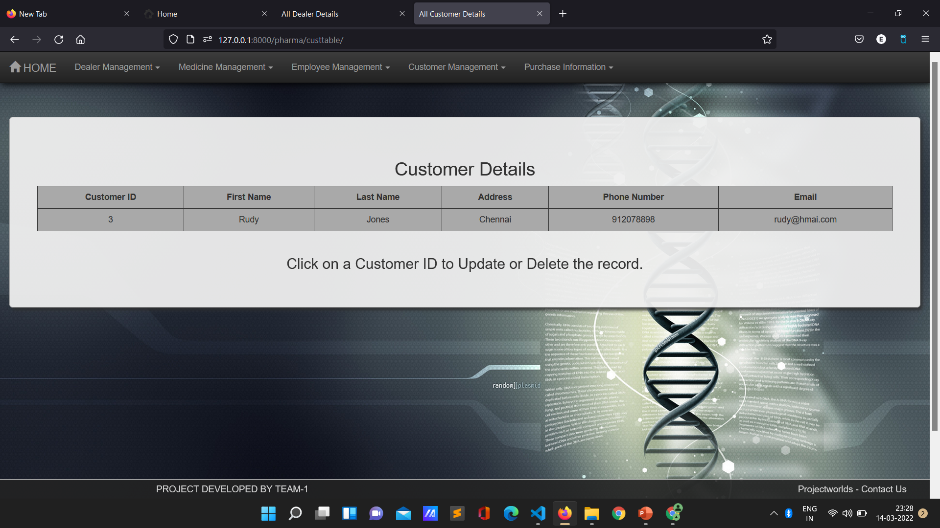

Slide 17
REFERENCES
1.Intelligent Hospital Management System (IHMS)
B. Koyuncu and H. Koyuncu, 2015
https://ieeexplore.ieee.org/document/7546371
2.Smart Hospital Management System: An integration of enterprise level solutions utilising open group
architecture framework (TOGAF)
Z. Chaczko, C. Chiu, Avtar Singh Kohli and V. Mahadevan,2010
https://ieeexplore.ieee.org/document/5564121

Slide 18
THANK YOU

